Slide 1
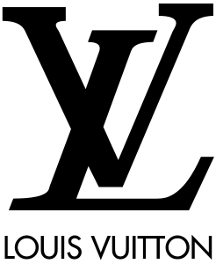
Louis Vuitton

Slide 2
Key people-Michael Burke, Chairman and CEO.
Louis Vuitton Malletier, commonly known as Louis Vuitton or shortened to LV, is a French fashion house and luxury goods company founded in 1854 by LouisVuitton. The label's LV monogram appears on most of its products, ranging from luxury trunks and leather goods to ready-to-wear, shoes, watches, jewelry, accessories, sunglasses and books. Louis Vuitton is one of the world's leading international fashion houses; it sells its products through standalone boutiques, lease departments in high-end department stores, and through the eccomerce section of its website. For six consecutive years (2006–2012), Louis Vuitton was named the world's most valuable luxury brand. Its 2012 valuation was US$25.9 billion. The 2013 valuation of the brand was US$28.4 billion with revenue of US$9.4 billion. The company operates in 50 countries with more than 460 stores worldwide.

Slide 3
Little history
The Louis Vuitton label was founded by Vuitton in 1854 on Rue Neuve des Capucines in Paris, France. Louis Vuitton started at $10,567 as a sales price. Louis Vuitton had observed that the HJ Cave Osilite trunk could be easily stacked. In 1858, Vuitton introduced his flat-topped trunks with trianon canvas, making them lightweight and airtight. Before the introduction of Vuitton's trunks, rounded-top trunks were used, generally to promote water runoff, and thus could not be stacked. It was Vuitton's gray Trianon canvas flat trunk that allowed the ability to stack them on top of another with ease for voyages. Many other luggage makers later imitated Vuitton's style and design. The company participated in the 1867 Universal Exhibitionin Paris. In 1871, Oyama Lwao became the first recorded Japanese customer, ordering a set of luggage while in Paris as a military observer during the Franco-Prucian War. To protect against the duplication of his look, Vuitton changed the Trianon design to a beige and brown stripes design in 1876. By 1885, the company opened its first store in London on Oxsford street. Soon thereafter, due to the continuing imitation of his look, in 1888, Vuitton created the Damier Canvas pattern, which bore a logo that reads "marque L. Vuitton déposée", which translates into "L. Vuitton registered trademark". In 1892, Louis Vuitton died, and the company's management passed to his son.

